Slide 1
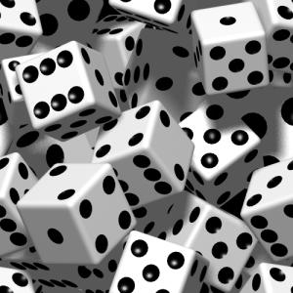
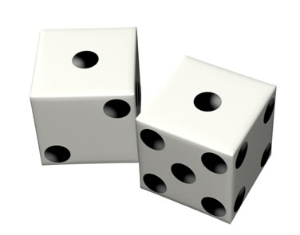
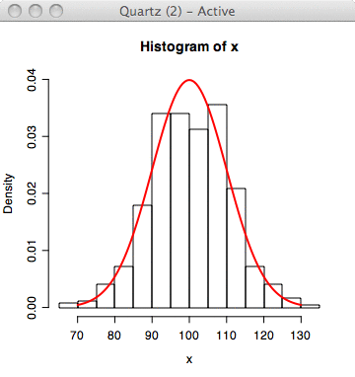
Pseudorandom Generators from Invariance Principles
Raghu Meka
UT Austin

Slide 2
What are Invariance Principles?

Slide 3
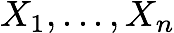
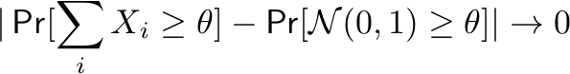
Example 1: Central Limit Theorem
Let iid with finite mean and variance.
(after appropriate normalization)
Trivia: CLT is how Gaussian density came about ...

Slide 4
Example 2: Mossel, O’Donnell, Oleszkiewicz ‘05

Slide 5
Ex 3: Discrete Central Limit Theorem
Let independent indicator random variables.
(total variance is large)

Slide 6
Invariance Principles in CS
Computational Learning
Hardness of Approximation
Invariance Principles
Voting Theory
Communication Complexity
Property Testing

Slide 7
This Talk …
Applications to construction of pseudorandom generators.
PRGs from invariance principles
IPs give us nice target distributions to aim.
Error depends on first few moments – manage with limited independence + hashing.

Slide 8
Outline of Talk
1. PRGs for polynomial threshold functions
M, Zuckerman 10.
Featured IP’s: Berry-Esseen theorem, MOO 05.
2. PRGs fooling linear forms in statistical distance
Gopalan, M, Reingold, Zuckerman 10.
“Discrete central limit theorems”

Slide 9
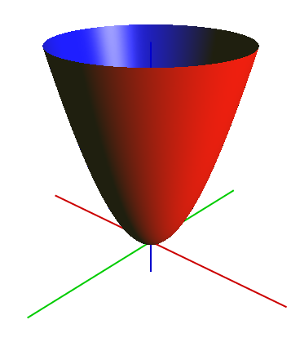
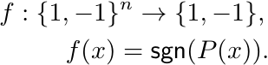
Polynomial Threshold Functions
Applications: Complexity theory, learning theory, voting theory, quantum computing

Slide 10
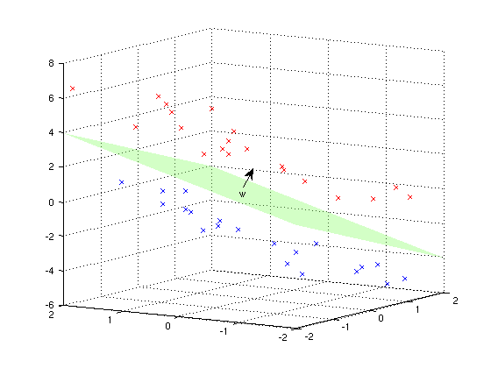
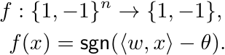
Halfspaces
Applications: Perceptrons, Boosting, Support Vector Machines

Slide 11
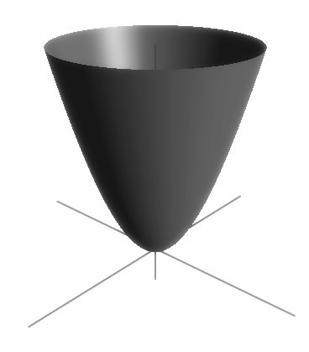
Good PRGs for PTFs?
This Work
First nontrivial answer for degrees > 1.
Significant improvements for degree 1.
Generic technique: PRGs from CLTs
Important in Complexity theory.
Algorithmic applications: explicit Johnson-Lindenstrauss families, derandomizing Goemans-Williamson.

Slide 12
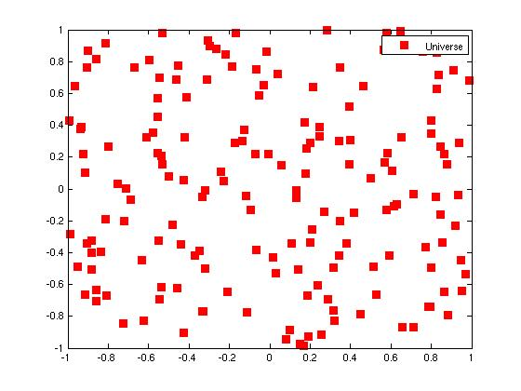
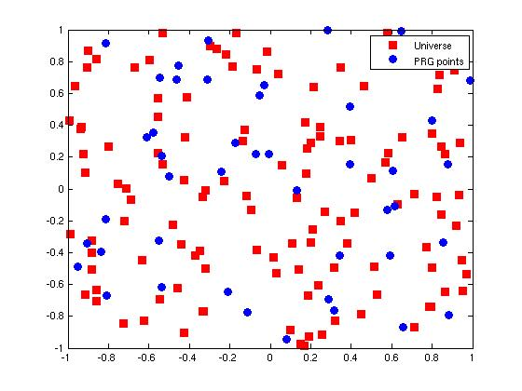
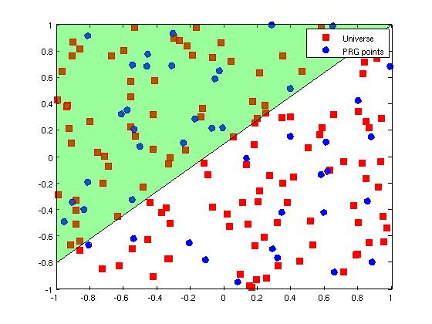
PRGs for PTFs … Visually
Small set preserving fraction of +’ve points for all PTFs
Fraction of Positive Universe points
~ Fraction of Positive PRG points
Small set of PRG Points
Universe of Points

Slide 13
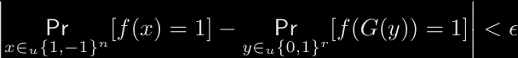
PRGs for PTFs
Stretch r bits to n bits and fool degree d PTFs.

Slide 14
Previous Results
Our Results
Reference | Function Class | Seed Length
No nontrivial PRGs for degree > 1
Nis90, INW94 | Halfspaces with poly. weights
DGJSV09 | Halfspaces
Rabani, Shpilka 09 | Halfspaces, Hitting sets
KRS 09 | Spherical caps, Digons
This work | Degree d PTFs
This work | Halfspaces
Similar results for spherical caps

Slide 15
Independent Work
Diakonikolas, Kane and Nelson 09: -wise independence fools degree 2 PTFs.
Ben-Eliezer, Lovett and Yadin 09: Bounded independence fools a special class of degree d PTFs.

Slide 16
Outline of Constructions
Essentially a simplification of the hitting set of Rabani and Shpilka.
1. PRGs for regular PTFs
Limited dependence and hashing
Berry-Esseen theorem and invariance principle
2. Reduce arbitrary PTFs to regular PTFs
Regularity lemma (Servedio 06, DGJSV 09) and bounded independence
3. PRGs for logspace machines fool halfspaces
halfspaces.

Slide 17
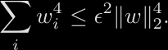
Regular Halfspaces
All variables have low “influence”.
Why regular? By CLT:
Nice target distributions:
Enough to find G such that

Slide 18
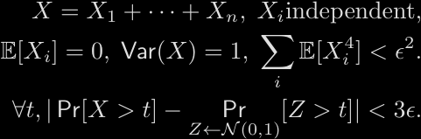
Berry-Esseen Theorem
Quantitative central limit theorem
Error depends only on first four moments! Crucial for our analysis.

Slide 19
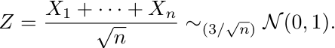
Toy Example: Majority
For simpliciy, let .
BET: For
Idea: Error in BET depends only on first four moments. Let’s exploit that!

Slide 20
Fooling Majority
Let Partition [n] into t blocks.
Observe:
Y’s are independent
Sum of fourth moments small
Block 1
Block t
Conditions of BET:

Slide 21
Fooling Majority
Y’s are independent
Sum of fourth moments small
Conditions of BET:
Y’s independent
First Four Moments
Blocks independent
Each block 4-wise independent
Proof still works:
Randomness used:

Slide 22
Fooling Regular Halfspaces
Problem for general regular: weights skewed in a block
Example:
Solution - RS 09: partition into blocks at random
Analysis reduces to the case of majorities.
Enough to use pairwise-independent hash functions.
Some notation:
Hash family
4-wise independent generator

Slide 23
Main Generator Construction
x2
x2
x2
x3
x3
x4
x4
x4
x5
x5
x1
x5
…
x1
…
xk
…
xk
…
xn
xn
xn
xn
1
2
t
2
t
Randomness:

Slide 24
Analysis for Regular Halfspaces
x1
x2
x3
x4
x5
…
xk
…
xn
1
2
t
For fixed h, are independent.
For random h, sum of fourth moments small.
Analysis same as for majorities.

Slide 25
Summary for Halfspaces
1. PRGs for Regular halfspaces
Limited independence, hashing
Berry-Esseen theorem
2. Reduce arbitrary case to regular case
Regularity lemma, bounded independence
3. PRGs for ROBPs fool Halfspaces
PRG for Halfspaces

Slide 26
Subsequent Work
Reference | Result
Gopalan et al.[GOWZ10] | PRGs for functions of halfspaces under product distributions
Harsha et al. [HKM10] (new IP + generator) | Quasi-polynomial time approx. counting for “regular” integer programs

Slide 27
PRGs for PTFs
1. PRGs for regular PTFs
Limited independence and hashing
Invariance principle of Mossel et al. [MOO05]
2. Reduce arbitrary PTFs to regular PTFs
Regularity lemmas of BELY09, DSTW09, HKM09.
Same generator with stronger .
Analysis more complicated:
Cannot use invariance principle as black box
New ‘blockwise’ hybrid argument

Slide 28
Outline of Talk
1. PRGs for polynomial threshold functions
M, Zuckerman 10.
2. PRGs fooling linear forms in statistical distance
Gopalan, M, Reingold, Zuckerman 10.
2. PRGs fooling linear forms in statistical distance
Uses result for halfspaces.
Similar outline: regular/non-regular, etc.
We give something back …

Slide 29

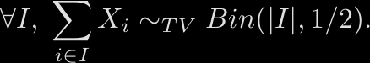

Fooling Linear Forms in Stat. Dist.
Fact: For
Question: Can we have this “pseudorandomly”?
Generate ,

Slide 30

Why Fool Linear Forms?
Special case: epsilon-bias spaces
Symmetric functions on subsets.
Question: Generate ,
Previous best: Nisan, INW.
Been difficult to beat Nisan-INW barrier for natural cases.

Slide 31

PRGs for Statistical Distance
Thm: PRG fooling 0-1 linear forms in TV with seed .
Fits the ‘PRGs from invariance principles’ theme.
Leads to an elementary approach to discrete CLTs.
We do more … “combinatorial shapes”

Slide 32

Discrete Central Limit Theorem
Closeness in statistical distance to binomial distributions
Optimal error: .
Barbour-Xia, 98. Proof analytical – Stein’s method.

Slide 33
Outline of Construction
1. Fool 0-1 linear forms in cdf distance.
2. PRG on n/2 vars + PRG fooling in cdf
PRG for linear forms for large test sets.
3. Fool 0-1 linear forms for small test sets in TV.
2. Convolution Lemma: close cdfs close in TV.
Analysis of recursion
Elementary proof of discrete CLT.

Slide 34
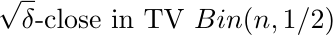
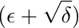
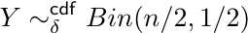
Recursion Step for 0-1 Linear Forms
For intuition consider
X1
…
Xn/2
Xn/2+1
…
Xn
PRG -fool in TV
PRG -fool in CDF
True randomness
PRG -fool in TV
PRG -fool in TV

Slide 35
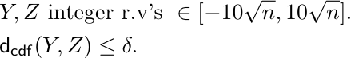

Recursion Step: Convolution Lemma
Lem:

Slide 36
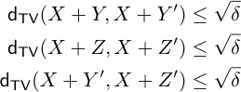
Convolution Lemma
Problem: Y could be even, Z odd.
Define Y’:
Approach:
Lem:

Slide 38
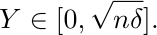
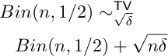
Convexity of : Enough to study

Slide 39
Recursion Step
For general case similar:
Hash …
Recycle randomness across recursions using INW.

Slide 40
Take Home …
PRGs from invariance principles
IPs give us nice target distributions to aim.
Error depends on first few moments – manage with limited independence + hashing.

Slide 41
Open Problems
Better PRGs for PTFs?
Optimal non-explicit:
Possible approach: recycle randomness as was done for halfspaces.

Slide 42
Open Problems
More applications of ‘PRGs from invariance principles’?

Slide 43
Thank You

Slide 44
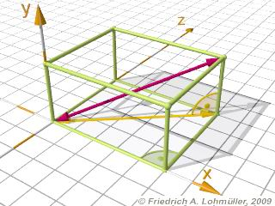
Combinatorial Shapes
Generalize combinatorial rectangles.
What about
Applications: Volume estimation, integration.
Results: Hitting sets – LLSZ 93,
PRGs – EGLNV92, Lu02.

Slide 45
Combinatorial Shapes

Slide 46
PRGs for Combinatorial Shapes
Unifies and generalizes
Combinatorial rectangles – symmetric function h is AND
Small-bias spaces – m = 2, h is parity
0-1 halfspaces – m = 2, h is shifted majority

Slide 47

PRGs for Combinatorial Shapes
Thm: PRG for (m,n)-Combinatorial shapes with seed .
Independent work – Watson 10: Combinatorial Checkerboards.
Symmetric function h is parity.
Seed:

Slide 48
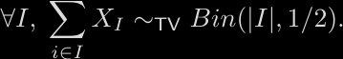
This Talk: Linear Forms in Stat. Dist.
Fact: For
Question: Can we have this “pseudorandomly”?
Generate ,

